Slide 1

Momentum
$$FΔt=mv_{f}−mv_{0}$$
Physics
Unit 4
Notes:
Physics Unit 4
NAD 2023 Standard F3 (Momentum)

Slide 2
Credits
This Slideshow was developed to accompany the textbook
  OpenStax High School Physics
    Available for free at https://openstax.org/details/books/physics
    By Paul Peter Urone and Roger Hinrichs
    2020 edition
Some examples and diagrams are taken from the OpenStax College Physics, Physics, and Cutnell & Johnson Physics 6th ed.
Slides created by
Richard Wright, Andrews Academy
rwright@andrews.edu

Slide 3
04-01 Impulse and Momentum
$$FΔt=mv_{f}−mv_{0}$$
In this lesson you will…
• Define impulse and linear momentum.
• Explain the relationship between momentum and force.
• Describe effects of impulses in everyday life.
Notes:
OpenStax High School Physics 8.1
OpenStax College Physics 2e 8.1-8.2

Slide 4
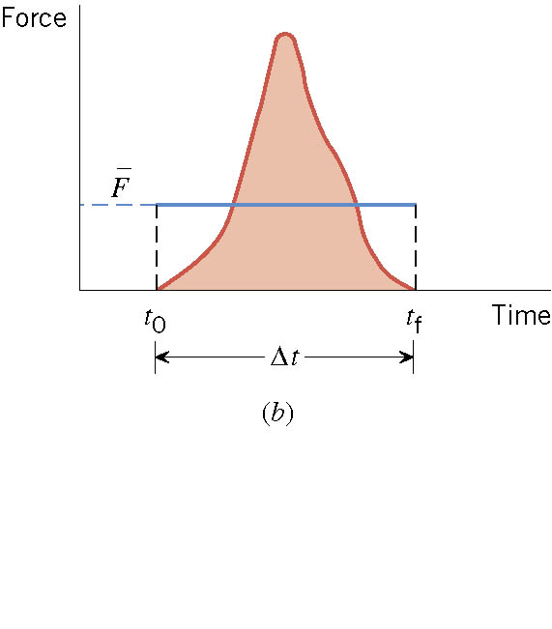
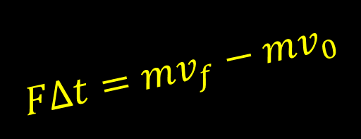
04-01 Impulse and Momentum
$$FΔt=mv_{f}−mv_{0}$$
Often the force acting on an object is not constant.
  Baseball or Tennis ball being hit
Times of force often short
Force can be huge

Slide 5
04-01 Impulse and Momentum
$$FΔt=mv_{f}−mv_{0}$$
To hit a ball well
  Both size of force and time of contact are important
  Bring both these together in concept of impulse

Slide 6

04-01 Impulse and Momentum
$$FΔt=mv_{f}−mv_{0}$$
Impulse
$$J=Ft$$
Unit: Ns
Is a vector

Slide 7
04-01 Impulse and Momentum
$$FΔt=mv_{f}−mv_{0}$$
Object responds to amount of impulse
Large impulse → Large response → higher v_{f}
Large mass → less velocity
Both mass and velocity play role in how responds to impulse

Slide 8

04-01 Impulse and Momentum
$$FΔt=mv_{f}−mv_{0}$$
Linear Momentum
$$p=mv$$
Unit: kg m/s
Is a vector
Is important when talking about collisions

Slide 9

04-01 Impulse and Momentum
$$FΔt=mv_{f}−mv_{0}$$
$$F=ma$$
$$a=\frac{v_{f}−v_{0}}{Δt}$$
$$F=m\frac{v_{f}−v_{0}}{Δt}=\frac{mv_{f}−mv_{0}}{Δt}$$
$$FΔt=mv_{f}−mv_{0}$$

Slide 10
04-01 Impulse and Momentum
$$FΔt=mv_{f}−mv_{0}$$
Impulse = Change in Momentum
Hard to measure force during contact
Find change in momentum
  Use impulse-Momentum Theorem and time of contact to find average force of contact

Slide 11
04-01 Impulse and Momentum
$$FΔt=mv_{f}−mv_{0}$$
In the following video
  Watch for the front of the car crumpling
  This increase the time of the collision
  Which decreases the force of the collision
    Given that the change in momentum is constant
  What other crash safety feature increases the time of collision?

Slide 12
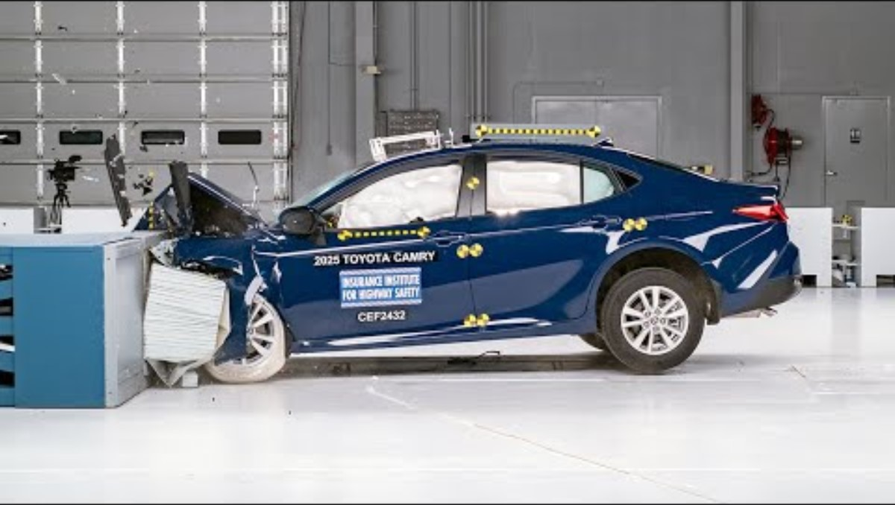
Notes:
$$FΔt=p_{f}−p_{0}$$
If the change in momentum is the same for several crashes, then the Force and time are inversely proportional.
The car crumple zone increases the time of the collision which decreases the average force of the collision.
The air bags do the same thing.
(2025 Toyota Camry updated moderate overlap IIHS crash test IIHS)

Slide 13
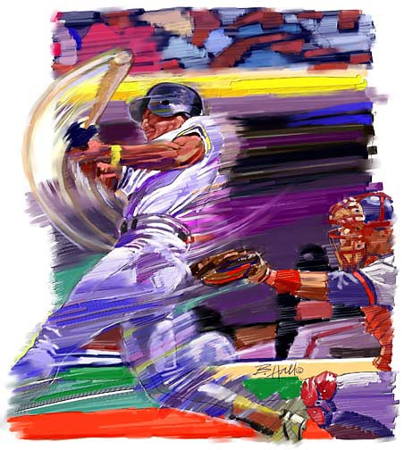
04-01 Impulse and Momentum
$$FΔt=mv_{f}−mv_{0}$$
A baseball (m = 0.14 kg) with initial velocity of −40 m/s (90 mph) is hit. It leaves the bat with a velocity of 60 m/s after 0.001 s. What is the impulse and average net force applied to the ball by the bat?
Impulse = 14 Ns
F = 14000 N
Notes:
$$FΔt=mv_{f}−mv_{0}$$
$$FΔt=\left(0.14 kg\right)\left(60\frac{m}{s}\right)−\left(0.14kg\right)\left(−40\frac{m}{s}\right)=14 kg m/s$$
$$F=\frac{14 kg\frac{m}{s}}{0.001 s}=14000 N$$

Slide 14
04-01 Impulse and Momentum
$$FΔt=mv_{f}−mv_{0}$$
A raindrop (m = 0.001 kg) hits a roof of a car at −15 m/s. After it hits, it spatters so the effective final velocity is 0. The time of impact is 0.01 s. What is the average force?
  F = 1.5 N
What if it is ice so that it bounces off at 10 m/s?
  F = 2.5 N
Notes:
$$Ft=mv_{f}−mv_{0}$$
$$F\left(0.01 s\right)=\left(0.001 kg\right)0−\left(0.001 kg\right)\left(−15\frac{m}{s}\right)$$
$$F\left(0.01 s\right)=0.015 kg\frac{m}{s}$$
$$F=1.5 N$$
$$F\left(0.01 s\right)=\left(0.001 kg\right)\left(10\frac{m}{s}\right)−\left(0.001 kg\right)\left(−15\frac{m}{s}\right)$$
$$F\left(0.01 s\right)=0.025 kg\frac{m}{s}$$
$$F=2.5 N$$
Hailstones are usually more massive than raindrops so that the force is even greater.
The rebounding adds force to the collision

Slide 15
04-01 Impulse and Momentum
$$FΔt=mv_{f}−mv_{0}$$
In the following video
  Old cars don’t have crumple zones
  Notice that the new car is much safer than the old car.

Slide 16
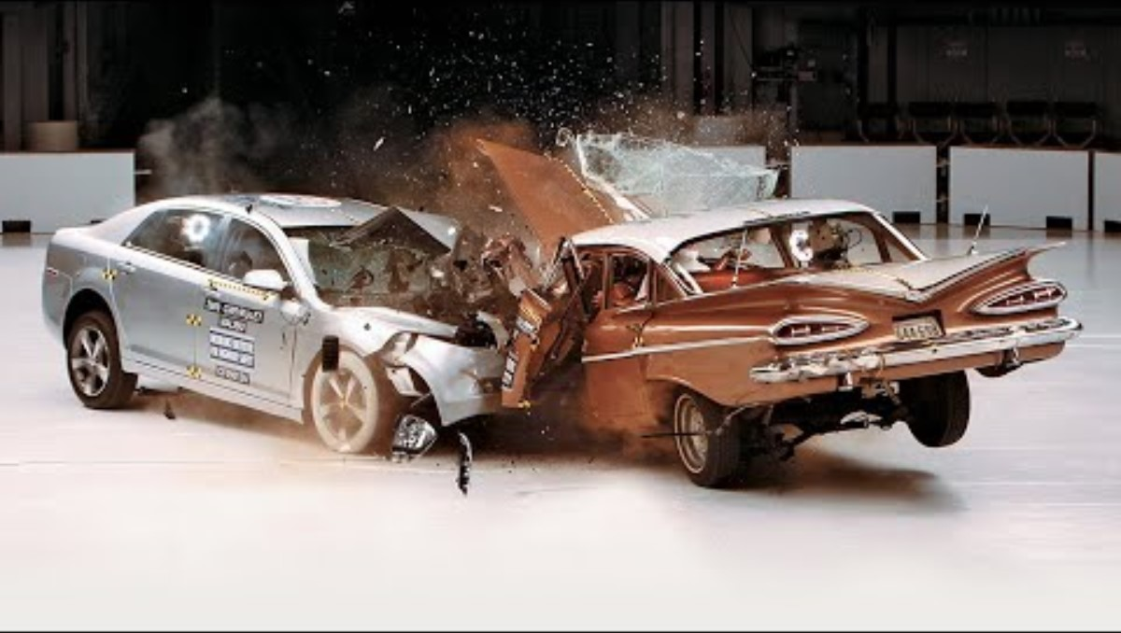
Notes:
$$FΔt=p_{f}−p_{0}$$
If the change in momentum is the same for several crashes, then the Force and time are inversely proportional.
The old car doesn’t have a crumple zone and the cockpit is crushed. The new car has a crumple zone and the driver is safe.
(1959 Chevrolet Bel Air vs. 2009 Chevrolet Malibu IIHS crash test)

Slide 17
04-02 Conservation of Momentum
$$FΔt=mv_{f}−mv_{0}$$
In this lesson you will…
• Describe the principle of conservation of momentum.
• Derive an expression for the conservation of momentum.
• Explain conservation of momentum with examples.
Notes:
OpenStax High School Physics 8.2
OpenStax College Physics 2e 8.3

Slide 18
04-01b Bumper Testing Lab
$$FΔt=mv_{f}−mv_{0}$$
Each team makes a bumper out of paper and tape.
  2.5 cm × 4 cm × 10 cm
  Do not use excessive tape
The bumper is placed against the end of the track.
The cart is released from a distance as set by the teacher.
The maximum force is read from the sensor.

Slide 19
04-02 Conservation of Momentum
$$FΔt=mv_{f}−mv_{0}$$
Do the lab in your worksheet.
Explain why if a person standing of frictionless ice shoots a bullet at 200 m/s does not move backwards are 200 m/s.
A 100 kg person pushes off from a 50 kg person on frictionless ice. If the 100 kg person moves at 3 m/s, what speed will the 50 kg person move at?
Notes:
The person has more mass than the bullet.
Since they are half the mass, they will move at twice the speed. Mass and speed ratios are reciprocals.

Slide 20
04-02 Conservation of Momentum
$$FΔt=mv_{f}−mv_{0}$$
System
  All the objects involved in the problem
  Usually only two objects
Internal Forces – Forces that the objects exert on each other
External Forces – Forces exerted by things outside of the system
Notes:
Usually only two objects for linear momentum because very rarely do more than two object hit at the same time. It usually happens that two hit, and then one of those hits another.
Internal forces → the objects pushing each other
External forces → gravity pulling the objects down

Slide 21
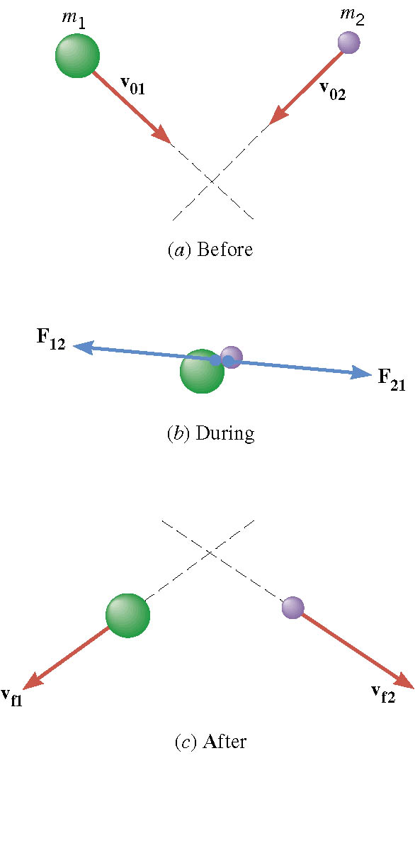
04-02 Conservation of Momentum
Two balls hit in the air
During the collision
  Internal Forces = F₁₂ and F₂₁
  External Forces = Weight (W₁ and W₂)
Notes:
F₁₂ and F₂₁ are action-reaction pair from Newton’s Third Law are equal and opposite

Slide 22

04-02 Conservation of Momentum
$$FΔt=mv_{f}−mv_{0}$$
$FΔt=mv_{f}−mv_{0}$
Object 1: $\left(W_{1}+F_{12}\right)Δt=m_{1}v_{f1}−m_{1}v_{01}$
Object 2: $\left(W_{2}+F_{21}\right)Δt=m_{2}v_{f2}−m_{2}v_{02}$
Add
$\left(W_{1}+W_{2}+F_{12}+F_{21}\right)Δt=\left(m_{1}v_{f1}+m_{2}v_{f2}\right)−\left(m_{1}v_{01}+m_{2}v_{02}\right)$
$\left(Ext F+Int F\right)Δt=p_{f}−p_{0}$

Slide 23
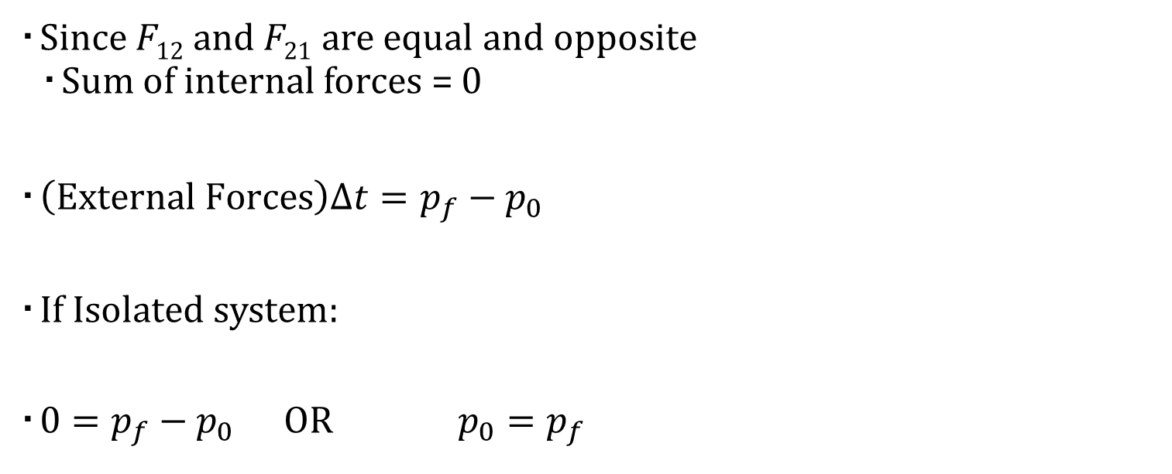
04-02 Conservation of Momentum
$$FΔt=mv_{f}−mv_{0}$$
Since F₁₂ and F₂₁ are equal and opposite
  Sum of internal forces = 0
$\left(External Forces\right)Δt=p_{f}−p_{0}$
If Isolated system:
$0=p_{f}−p_{0}$ OR $p_{0}=p_{f}$
Notes:
Isolated system = no external forces

Slide 24

04-02 Conservation of Momentum
$$FΔt=mv_{f}−mv_{0}$$
Law of Conservation of Momentum
  In an isolated system the total momentum remains constant
$$p_{0}=p_{f}$$
  System can contain any number of objects
Watch Crash Video

Slide 25
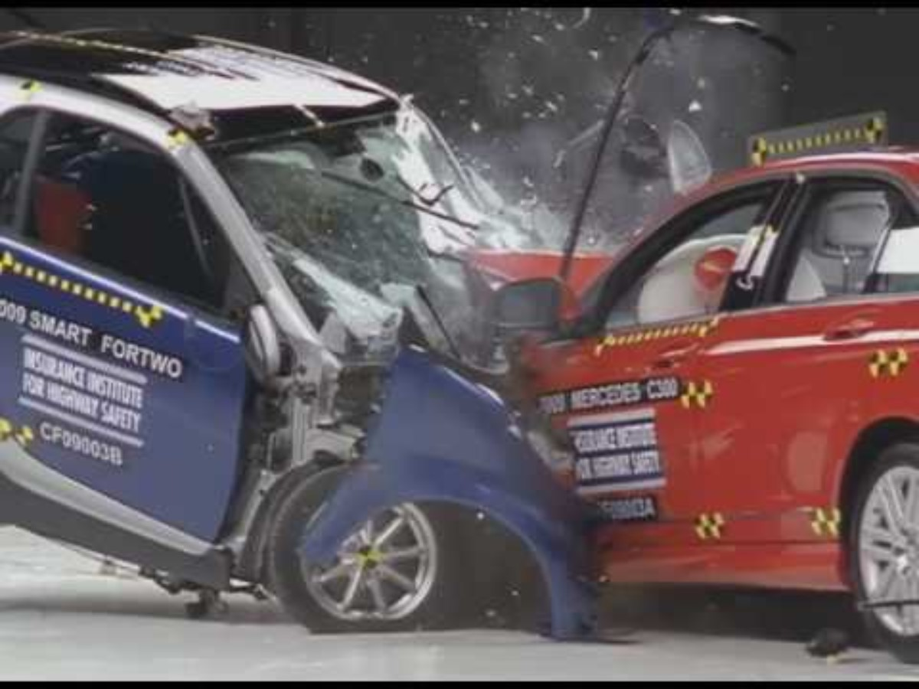
Notice how the lighter car always bounces backwards.
Conservation of Momentum predicts this
Notes:
Safety consequences of vehicle size and weight by IIHS

Slide 26
04-02 Conservation of Momentum
$$FΔt=mv_{f}−mv_{0}$$
Reasoning Strategy
Decide on the system
Identify internal and external forces
Is the system isolated? If no, then can’t use conservation of momentum
Set the total initial momentum of the isolated system equal to the total final momentum

Slide 27
04-02 Conservation of Momentum
$$FΔt=mv_{f}−mv_{0}$$
Two billiard balls are colliding on a table. In order to apply the law of conservation of momentum, what should the system be? One ball or both billiard balls?
  Two billiard balls.
External Forces: Weight and Normal Force
  If the table is horizontal these cancel
If it were one ball, then the force of the second ball hitting it would not cancel with anything.

Slide 28
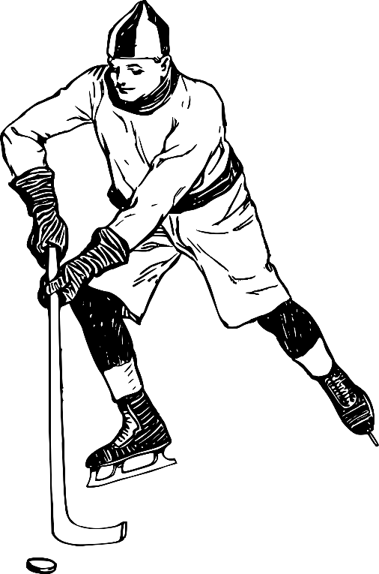
04-02 Conservation of Momentum
$$FΔt=mv_{f}−mv_{0}$$
A hockey puck of mass 0.17 kg and velocity 5 m/s is caught by a 0.5 kg mitten laying on the ice. What is the combined velocity after the puck is in the mitten? (ignore friction)
v = 1.27 m/s
Notes:
$$p_{0}=p_{f}$$
$$m_{1}v_{01}+m_{2}v_{02}=m_{1}v_{f1}+m_{2}v_{f2}$$
$$\left(0.17 kg\right)\left(5 \frac{m}{s}\right)+\left(0.5 kg\right)\left(0\frac{m}{s}\right)=\left(0.17 kg\right)v+\left(0.5 kg\right)v$$
$$0.85 kg\frac{m}{s}=\left(0.67 kg\right)v$$
$$v=1.27 m/s$$

Slide 29
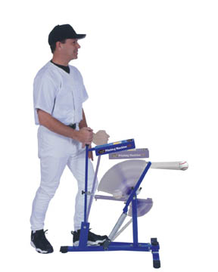
04-02 Conservation of Momentum
$$FΔt=mv_{f}−mv_{0}$$
A 5 kg baseball pitching machine is placed on some frictionless ice. It shoots a 0.15 kg baseball horizontally at 35 m/s. How fast is the pitching machine moving after it shoots the ball?
−1.05 m/s
This is why you feel recoil
when you shoot a gun
Notes:
$$p_{0}=p_{f}$$
$$m_{1}v_{01}+m_{2}v_{02}=m_{1}v_{f1}+m_{2}v_{f2}$$
$$\left(5 kg\right)\left(0\right)+\left(0.15 kg\right)\left(0\right)=\left(5 kg\right)v+(0.15kg)(35 m/s)$$
$$0=\left(5 kg\right)v+5.25 kg m/s$$
$$−(5 kg)v=5.25 kg m/s$$
$$v=−1.05 m/s$$

Slide 30
04-03 Elastic and Inelastic Collisions
$$FΔt=mv_{f}−mv_{0}$$
In this lesson you will…
• Describe an elastic collision of two objects in one dimension.
• Determine the final velocities in an elastic collision given masses and initial velocities.
• Define inelastic collision.
• Explain perfectly inelastic collision.
Notes:
OpenStax High School Physics 8.3
OpenStax College Physics 2e 8.4-8.5

Slide 31
04-03 Elastic and Inelastic Collisions
$$FΔt=mv_{f}−mv_{0}$$
Newton’s Cradle Lab
Lay the ruler perfectly horizontal and put the marbles in the center touching each other.
From one end, roll a marble so that it hits the other four. What happens?
From one end, roll two marbles so that it hits the other three. What happens?
From one end, roll three marbles so that it hits the other two. What happens?
From one end, roll four marbles so that it hits the other one. What happens?
Roll one marble extra fast to try to get two marbles to come out at half the speed.
If a marble of mass m comes in at velocity v and stops and an identical marble flies out the other side, what will its velocity have to be to conserve momentum?
Show that momentum was conserved in steps 3-7.
Show that momentum would be conserved in step 7, but kinetic energy would not be conserved if two marbles came out at half the speed.
Notes:
4. One flies out
5. Two fly out
6. Three fly out
7. Four fly out
8. Can’t
9. v
10. mv is the same before and after
11. mv is the same before and after, but $KE=\frac{1}{2}mv^{2}$ will not be the same because of the v²
$$KE=KE$$
$$\frac{1}{2}m{\left(2v\right)}^{2}=\frac{1}{2}mv^{2}+\frac{1}{2}mv^{2}$$
$$2mv^{2}≠mv^{2}$$

Slide 32
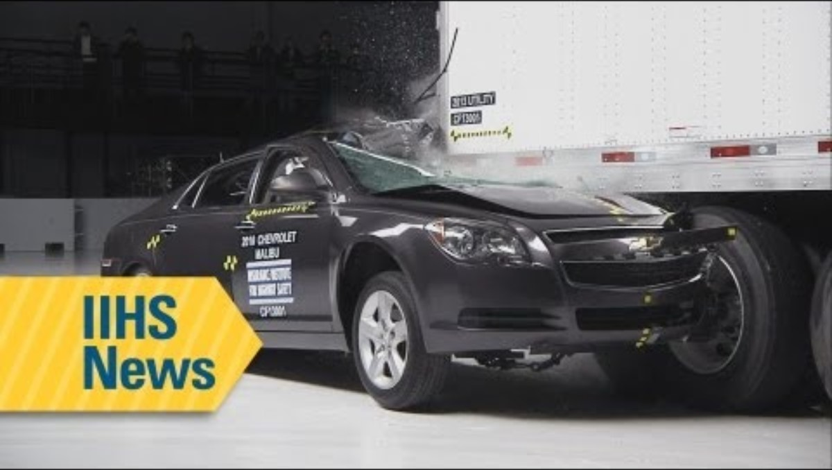
Notes:
This video is just FYI about semi truck trailers and crashes. Note that many old trailers are still on the road.
(Most underride guards fail to stop deadly crashes - IIHS news – YouTube)

Slide 33

04-03 Elastic and Inelastic Collisions
$$FΔt=mv_{f}−mv_{0}$$
Kinetic Energy
  Energy of motion
  $KE=\frac{1}{2}mv^{2}$
Notes:
Demo energy lost to heat by smashing two steel balls together

Slide 34
04-03 Elastic and Inelastic Collisions
$$FΔt=mv_{f}−mv_{0}$$
Subatomic – kinetic energy often conserved
Macroscopic – kinetic energy usually not conserved
  Converted into heat
  Converted into distortion or damage
Notes:
Demo energy lost to heat by smashing two steel balls together

Slide 35
04-03 Elastic and Inelastic Collisions
$$FΔt=mv_{f}−mv_{0}$$
Elastic – kinetic energy conserved
Inelastic – kinetic energy not conserved
Completely inelastic – the objects stick together
Notes:
SUV crash test video
NASCAR video
Crash test humor

Slide 36
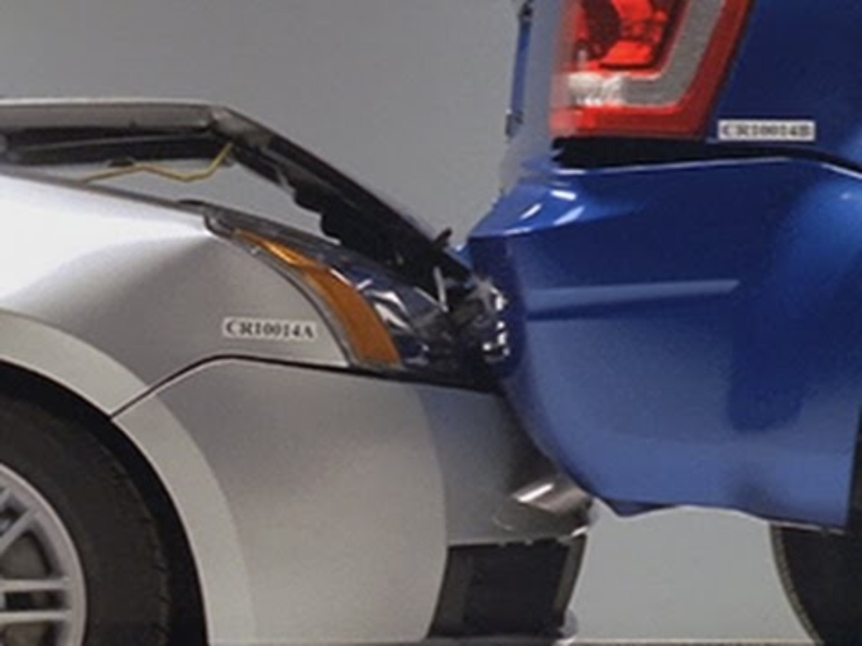
Bumpers are supposed to protect your car from minor accidents and provide elastic collisions are low speeds
Notes:
(Huge cost of mismatched bumpers by IIHS)

Slide 37
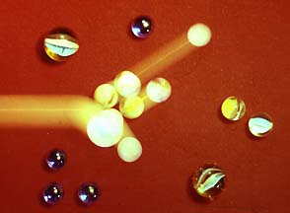
04-03 Elastic and Inelastic Collisions
$$FΔt=mv_{f}−mv_{0}$$
You are playing marbles. Your 0.10 kg shooter traveling at 1.0 m/s hits a stationary 0.050 kg cat’s eye marble. If it is an elastic collision what are the velocities after the collision?
v_{c} = 1.33 m/s
v_{s} = .333 m/s
Notes:
Momentum
$$m_{s}v_{0s}+m_{c}v_{0c}=m_{s}v_{fs}+m_{c}v_{fc}$$
$$\left(0.1 kg\right)\left(1\frac{m}{s}\right)+\left(0.05 kg\right)\left(0\right)=\left(0.1 kg\right)v_{fs}+\left(0.05 kg\right)v_{fc}$$
$$0.1 kg\frac{m}{s}=\left(0.1 kg\right)v_{fs}+\left(0.05 kg\right)v_{fc}$$
$$v_{fs}=1 m/s−0.5 v_{fc}$$
Kinetic Energy
$$\frac{1}{2}m_{s}v_{0s}^{2}+\frac{1}{2}m_{c}v_{0c}^{2}=\frac{1}{2}m_{s}v_{fs}^{2}+\frac{1}{2}m_{c}v_{fc}^{2}$$
$$\frac{1}{2}\left(0.1 kg\right){\left(1\frac{m}{s}\right)}^{2}+0=\frac{1}{2}\left(0.1 kg\right)v_{fs}^{2}+\frac{1}{2}\left(0.05 kg\right)v_{fc}^{2}$$
$$0.05 J=\left(0.05 kg\right)v_{fs}^{2}+\left(0.025 kg\right)v_{fc}^{2}$$
$$v_{fs}^{2}+0.5 v_{fc}^{2}=1 {\left(\frac{m}{s}\right)}^{2}$$
$${\left(1\frac{m}{s}−0.5v_{fc}\right)}^{2}+0.5 v_{fc}^{2}=1 {\left(\frac{m}{s}\right)}^{2}$$
$$1 {\left(\frac{m}{s}\right)}^{2}−\left(1\frac{m}{s}\right)v_{fc}+0.25 v_{fc}^{2}+0.5 v_{fc}^{2}=1 {\left(\frac{m}{s}\right)}^{2}$$
$$−\left(1\frac{m}{s}\right)v_{fc}+0.75 v_{fc}^{2}=0$$
$$v_{fc}\left(−1\frac{m}{s}+0.75 v_{fc}\right)=0$$
$$v_{fc}=0 or 1.33 m/s$$
$$v_{fs}=1\frac{m}{s}−0.5 v_{fc}$$
$$V_{fs}=1 m/s−0.5(1.33 m/s)=0.333 m/s$$

Slide 38
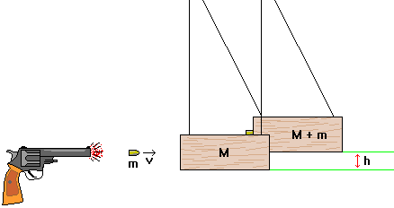
04-03 Elastic and Inelastic Collisions
$$FΔt=mv_{f}−mv_{0}$$
A ballistic pendulum can be used to determine the muzzle velocity of a gun. A .01 kg bullet is fired into a 3 kg block of wood. The block is attached with a thin .5m wire and swings to an angle of 40°. How fast was the bullet traveling when it left the gun?
v = 455 m/s
Notes:
Do an actual demonstration
Collision
$$m_{b}v_{0b}+m_{w}v_{0w}=m_{b}v_{fb}+m_{w}v_{fw}$$
$$\left(0.01 kg\right)v_{0b}+0=\left(0.01 kg\right)v_{f}+\left(3 kg\right)v_{f}$$
$$\left(0.01 kg\right)v_{0b}=\left(3.01 kg\right)v_{f}$$
After collision
$$h=0.5 m−0.5 m\cos{40°}=0.1170 m$$
$$PE_{0}+KE_{0}=PE_{f}+KE_{f}$$
$$0+\frac{1}{2}\left(3.01 kg\right)v_{f}^{2}=\left(3.01 kg\right)\left(9.8\frac{m}{s^{2}}\right)(0.1170 m)+0$$
$$1.505 kg v_{f}^{2}=3.45 J$$
$$v_{f}=1.51 m/s$$
Combine
$$\left(0.01 kg\right)v_{0b}=\left(3.01 kg\right)\left(1.51\frac{m}{s}\right)$$
$$v_{0b}=455 m/s$$

Slide 39
04-03 Elastic and Inelastic Collisions
$$FΔt=mv_{f}−mv_{0}$$
Police will sometime reconstruct car accidents. In one accident, the cars stuck together and slid 12 m before they stopped. They measure the coefficient of friction as 0.70. The blue car’s mass is 1100 kg and was sitting still at a stop sign when it was hit by the red car whose mass is 990 kg. How fast was the red car going when it hit the blue car?
Notes:
Work backwards
Find acceleration after collision:
$$v^{2}=v_{0}^{2}+2a\left(d−d_{0}\right)$$
$$0^{2}=v_{0}^{2}+2a\left(12 m−0m\right)$$
$$−\frac{v_{0}^{2}}{24 m}=a$$
Forces (cars stuck together m=2090 kg):
$$μF_{N}=ma$$
$$−\left(0.70\right)\left(mg\right)=ma$$
$$−\left(0.70\right)\left(9.8\frac{m}{s^{2}}\right)=−\frac{v_{0}^{2}}{24 m}$$
$$164.64\frac{m^{2}}{s^{2}}=v_{0}^{2}$$
$$v_{0}=12.83\frac{m}{s}$$
Use momentum ($v_{0}$ is now final v):
$$m_{1}v_{01}+m_{2}v_{02}=m_{1}v_{1}+m_{2}v_{2}$$
$$\left(1100 kg\right)\left(0\frac{m}{s}\right)+\left(990 kg\right)v_{02}=\left(1100 kg\right)\left(12.83\frac{m}{s}\right)+\left(990 kg\right)\left(12.83\frac{m}{s}\right)$$
$$\left(990 kg\right)v_{02}=26817.2 kg\frac{m}{s}$$
$$v_{02}=27.1\frac{m}{s}$$

Slide 40
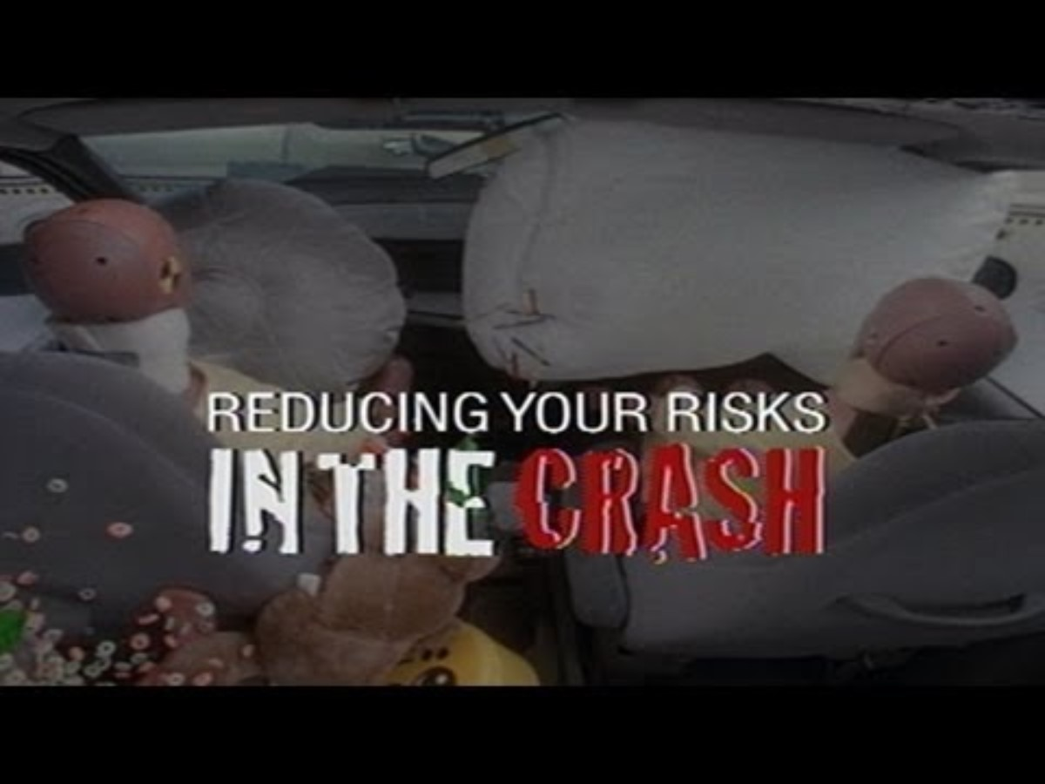
What can you do to stay safer in a car crash?
Notes:
Keeping children safe in crashes: Overview – YouTube IIHS
Keeping children safe in crashes: Rear facing IIHS
Keeping children safe in crashes: Forward facing – YouTube IIHS
Keeping children safe in crashes: Booster seats – YouTube IIHS
Reducing Your Risks In The Crash – YouTube IIHS

Slide 41
04-04 Angular Momentum
In this lesson you will…
• Understand the analogy between angular momentum and linear momentum.
• Observe the relationship between torque and angular momentum.
• Apply the law of conservation of angular momentum.
Notes:
Not in OpenStax High School Physics
OpenStax College Physics 2e 10.5

Slide 42
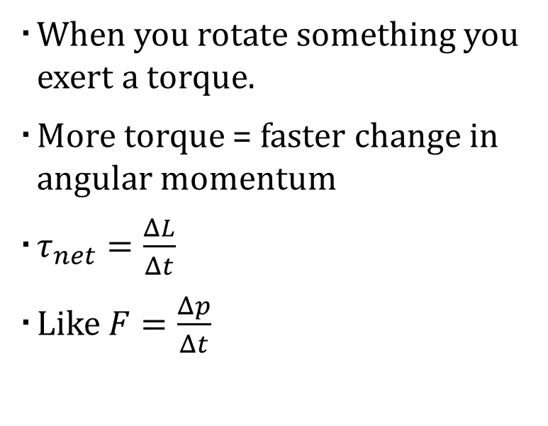
04-04 Angular Momentum
Linear momentum
  p = mv
Angular momentum
  L = Iω
  Unit:
  kg m²/s
  ω must be in rad/s
When you rotate something you exert a torque.
More torque = faster change in angular momentum
$τ_{net}=\frac{ΔL}{Δt}$
Like $F=\frac{Δp}{Δt}$
Notes:
Demo with the rotation rods
I is like m for rotational motion

Slide 43

04-04 Angular Momentum
Linear momentum of a system is conserved if $F_{net}=0$
  p₀ = p_{f}
Angular momentum of a system is also conserved if $τ_{net}=0$
  L₀ = L_{f}

Slide 44
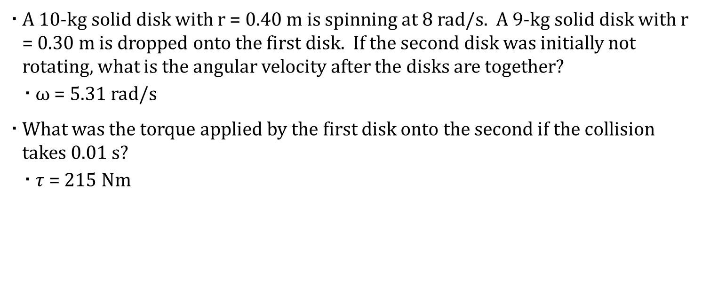
04-04 Angular Momentum
A 10-kg solid disk with r = 0.40 m is spinning at 8 rad/s. A 9-kg solid disk with r = 0.30 m is dropped onto the first disk. If the second disk was initially not rotating, what is the angular velocity after the disks are together?
  ω = 5.31 rad/s
What was the torque applied by the first disk onto the second if the collision takes 0.01 s?
  $τ$ = 215 Nm
Notes:
Disk 1:
$$ω_{0}=8\frac{rad}{s}, r=0.4 m, m=10 kg$$
$$I=\frac{1}{2}MR^{2}=\frac{1}{2}\left(10 kg\right){\left(0.4 m\right)}^{2}=0.8 kg⋅m^{2}$$
Disk 2:
$$ω_{0}=0\frac{rad}{s}, r=0.3 m, m=9 kg$$
$$I=\frac{1}{2}MR^{2}=\frac{1}{2}\left(9 kg\right){\left(0.3 m\right)}^{2}=0.405 kg m^{2}$$
$$L=Iω$$
$$L_{0}=L_{f}$$
$$\left(0.8 kgm^{2}\right)\left(8\frac{rad}{s}\right)+\left(0.405 kgm^{2}\right)\left(0\right)=\left(0.8 kgm^{2}+0.405 kgm^{2}\right)ω$$
$$6.4 kgm^{2}=\left(1.205 kgm^{2}\right)ω$$
$$ω=5.31 rad/s$$
$$τ=\frac{ΔL}{Δt}$$
$$τ=\frac{0.405 kgm^{2}\left(5.31\frac{rad}{s}\right)−0}{0.01 s}=215.055 Nm$$

Slide 45
04-04 Angular Momentum
Angular Momentum conserved if net external torque is zero
Linear Momentum conserved if net external force is zero
Kinetic Energy conserved if elastic collision

Slide 46
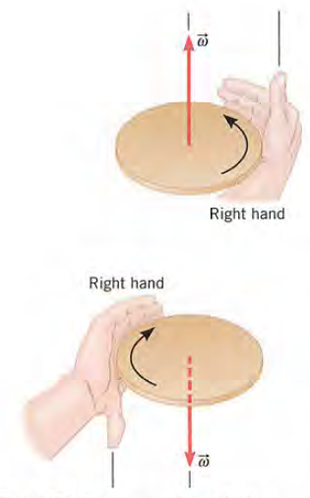
04-04 Angular Momentum
Direction of angular quantities
  Right-hand Rule
  Hold hand out with thumb out along axis
  Curl your fingers in direction of motion (you may have to turn your hand upside down)
  vector in direction of thumb

Slide 47
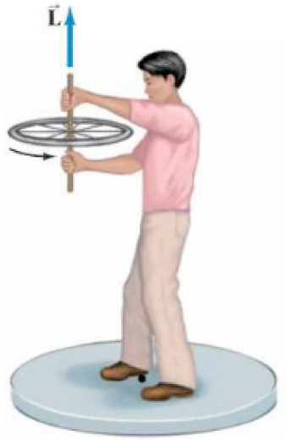
04-04 Angular Momentum
A person is holding a spinning bicycle wheel while he stands on a stationary frictionless turntable. What will happen if he suddenly flips the bicycle wheel over so that it is spinning in the opposite direction?
Notes:
Consider the system of turntable, person, and wheel. The total angular momentum before is L upward. Afterward, the total angular momentum must be the same. If the wheel is upside down, its angular momentum is –L so the angular momentum of the person must be +2L. So the person rotates in the direction the wheel was initially spinning.

Slide 48
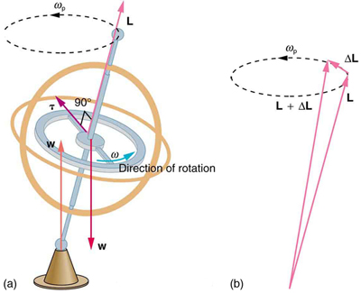
04-04 Angular Momentum
Gyroscopes
Two forces acting on a spinning gyroscope. The torque produced is perpendicular to the angular momentum, thus the direction of the torque is changed, but not its magnitude. The gyroscope precesses around a vertical axis, since the torque is always horizontal and perpendicular to L .
If the gyroscope is not spinning, it acquires angular momentum in the direction of the torque ( L = ΔL ), and it rotates around a horizontal axis, falling over just as we would expect.
Notes:
Use right-hand rule to find direction of torque.
Earth itself acts like a gigantic gyroscope. Its angular momentum is along its axis and points at Polaris, the North Star. But Earth is slowly precessing (once in about 26,000 years) due to the torque of the Sun and the Moon on its nonspherical shape.

